Slide 1
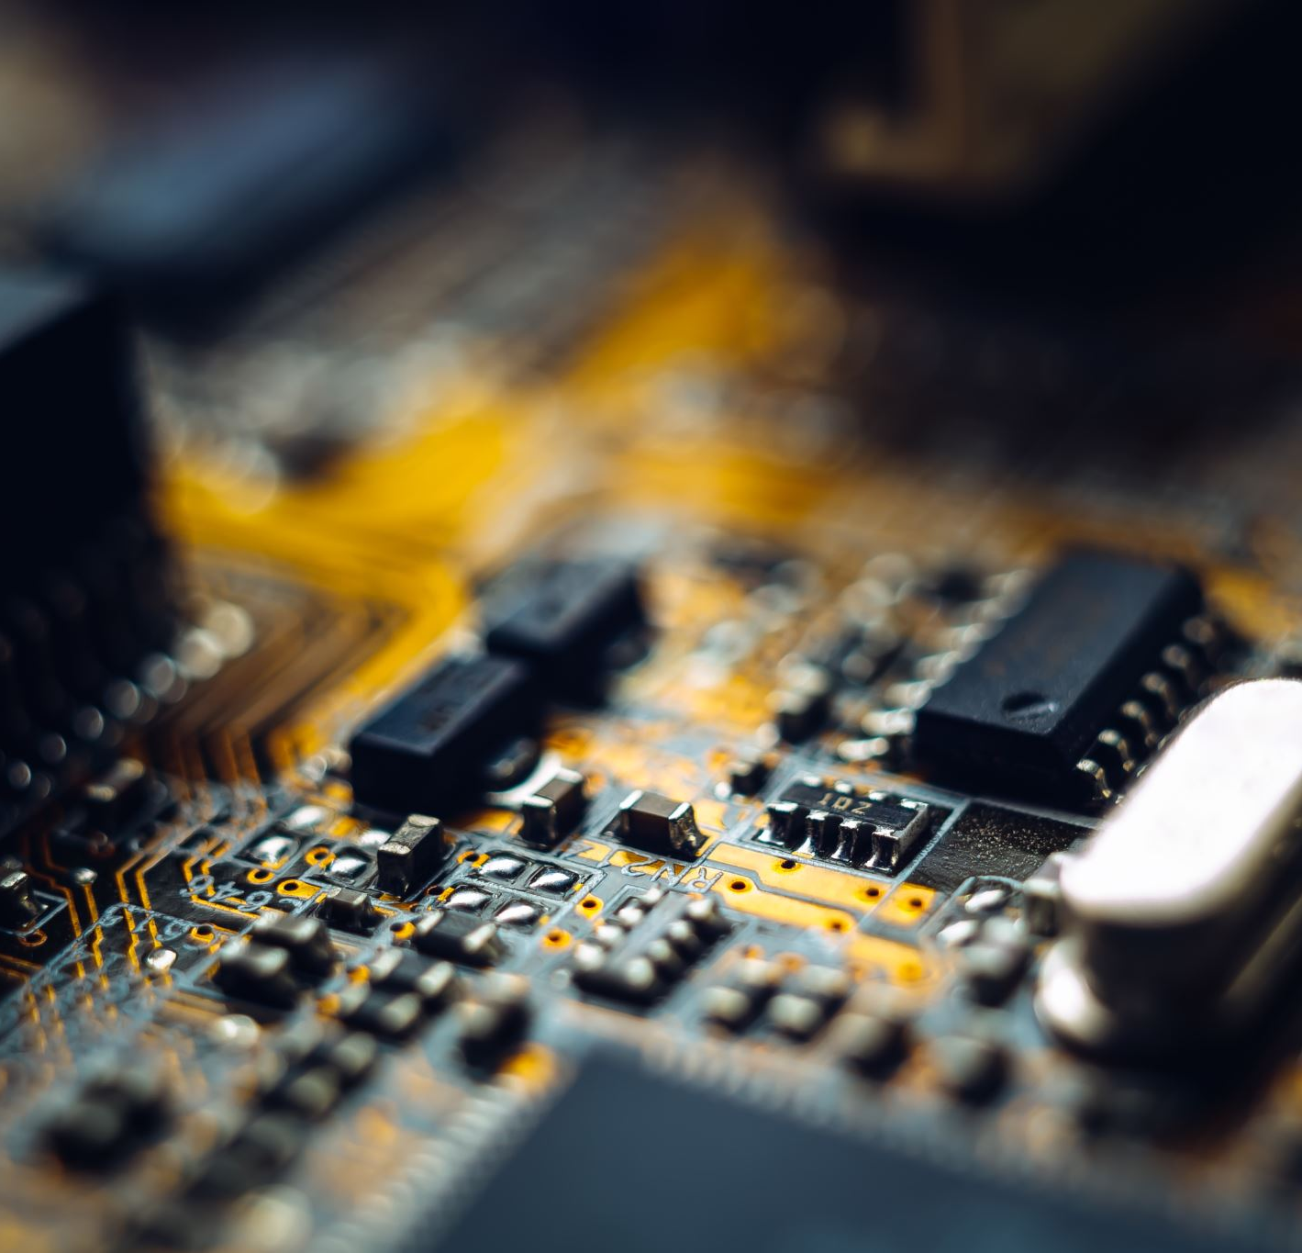



Smart Home
By Team Exemplary

Slide 2
Protocols
Disadvantages of current smart homes- Tasawar Siddiquy, ASM Nurussafa & Neaz Mahmud.
Ideas & Sketching – Asm Nurussafa, Neaz Mahmud & Tasawar Siddiquy

